Slide 1

Triage Dataset
L00172671 - Oisin Gibson

Slide 2

AI Medical Doctor: Predicting Patient Risk Using Machine Learning
This project explores how an AI system can be used to assist medical professionals during triage. It works by predicting a patients risk levels using machine learning.
Notes:
This project focuses on developing a simple AI-based medical system that can predict a patient’s risk level using machine learning techniques. The goal is to simulate how AI could assist doctors in early-stage decision making.

Slide 3

Project Aim
The overall aims of this project is to develop a machine learning model which can be used to analysis triage data.
The model would classify the patients into one of the following categories based on the factors present in the data set:
Low Risk
Medium Risk
High Risk
This model aims to simulate a real-world AI health support tool which could be used by professionals.
Notes:
The main aim of this project is to build a simple AI model that can classify patients into low, medium, or high risk categories based on their symptoms and vital signs. This reflects how AI could assist in triage situations.

Slide 4
Research Question
This project was built around answering the following question:
Can machine learning accurately predict risk level based on a patients symptoms and vital signs ?
As part of this there is a focuses on the early—stage decision making process
Answering this question aims to support triage systems used in the healthcare sector
Notes:
This research question is important because early detection of high-risk patients can lead to faster treatment and better outcomes. The goal is to see if machine learning can support this process.

Slide 5
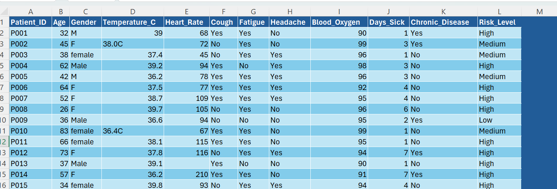
Dataset Description
The dataset (AI generated) contains 100 patient records.
The dataset contains the following properties:
Demographics (Age, Gender)
Temperature
Heart Rate
Blood Oxygen
Symptoms ( Cough, Fatigue, Headache)
Chronic Disease
The target variable for this model is the Risk Level
Notes:
The dataset was created manually to ensure originality. It contains 100 patient records with realistic medical attributes that are commonly used in clinical assessments.

Slide 6
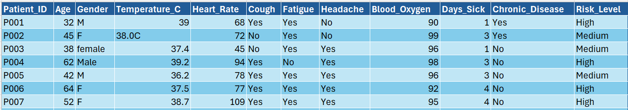
Data Cleaning
As per the instructions, the dataset needed to be cleaned before it could be processed.
The following steps where taken during the cleaning process:
Handling of the missing values – mean replacement
Standardised gender values – either M or F rather that Male/M
Removed the unrealistic values or the outliers– invalid age and extreme heart rate
Fixed the formatting issues – 39C became 39.0 – this made it more workable as numerical data
Converted the categorical data to numeric – made the process smoother for machine learning
Notes:
Data cleaning was a critical step because raw data is often unreliable. Missing values were replaced using the mean to preserve the dataset size. Inconsistent formats were standardised to ensure uniformity. Outliers and unrealistic values were removed to prevent the model from learning incorrect patterns.

Slide 7

Feature Selection
Not all the information in the dataset was relevant for the purposes of this experiment. The Patient_ID was one such column that was removed.
The following are a the selected key medical features used in this experiment:
Temperature
Heart Rate
Blood Oxygen
Symptoms
Notes:
Feature selection ensures that only relevant variables are used in the model. Irrelevant features can reduce accuracy and increase complexity. Encoding categorical variables into numerical form was necessary for the machine learning algorithm to process the data.
This step improves both model performance and interpretability.

Slide 8
Model Choice
The choice was made to implement a Decision Tree model as it most closet resembles how a medical professional would make decisions. It also proved to be more suitable for classification problems such as this.
The following were primary reasons for choosing a Decision Tree model:
Easy to understand
Interpretable
Mimics doctor based decision making
Uses rule-based logic
Notes:
A Decision Tree model was chosen because it closely resembles how doctors make decisions, using thresholds like high temperature or low oxygen levels. It is also easy to interpret visually.
Its interpretability is particularly important in healthcare, where understanding how decisions are made is essential.

Slide 9
Code Section
Notes:
I will now demonstrate how the dataset was processed and how the machine learning model was implemented.

Slide 10
Model Results
Accuracy – 94.7%
Showed strong overall performance
High accuracy on the unseen test data
Model generalises well
Notes:
The model achieved an accuracy of 94.7%, which indicates a strong ability to correctly classify patient risk levels on unseen data. This suggests that the model has learned meaningful patterns from the dataset rather than simply memorising the training data.
However, accuracy alone can sometimes be misleading, especially when class distributions are imbalanced. Therefore, additional evaluation metrics were used to gain a more complete understanding of model performance.

Slide 11
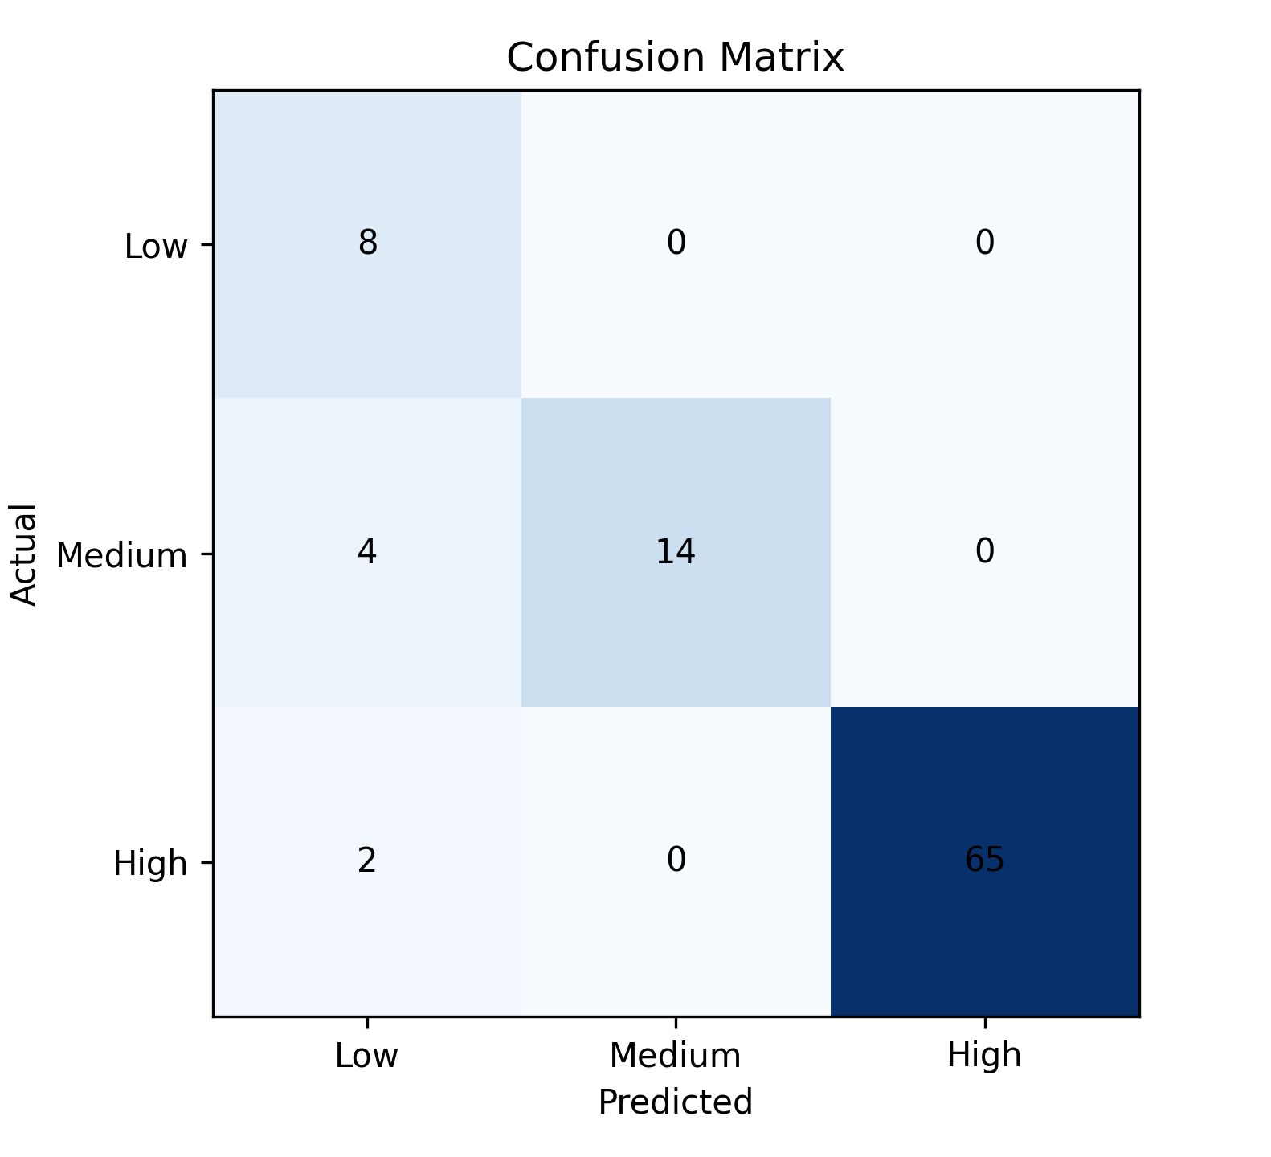
Confusion Matrix
Perfect classification of the high-risk patients
Minor errors in the medium-risk category
No low-risk samples in the test set
Highlights the class imbalance
Notes:
The confusion matrix shows that all high-risk patients were correctly identified, which is extremely important in a medical context. This means the model did not miss any critical cases.
However, the model struggled slightly with medium-risk patients, misclassifying some of them. This reflects the inherent difficulty in distinguishing borderline cases.
There were no low-risk samples in the test set, which means the model could not be evaluated on that category. This is a limitation of the dataset rather than the algorithm itself.
This highlights the importance of balanced datasets in machine learning, particularly in healthcare applications.

Slide 12

Classification Report
High Risk
Precision: 1.00
Recall: 1.00
Medium Risk
Recall: 0.50
Low Risk
No evaluation possible
Notes:
The classification report provides deeper insight into model performance. For high-risk patients, both precision and recall are 1.00, meaning the model correctly identified all high-risk cases without false positives or false negatives.
This is particularly important because failing to identify a high-risk patient could have serious consequences.
The lower recall for medium-risk patients indicates that some were incorrectly classified, likely due to overlapping symptom patterns.
This reflects a common challenge in classification problems where intermediate classes are less dist

Slide 13
Feature Importance
Most influential features:
Temperature
Blood Oxygen
Heart Rate
Less important:
Symptoms
Notes:
The feature importance analysis shows that vital signs such as temperature, blood oxygen, and heart rate had the greatest influence on predictions.
👉 Deep reasoning:
This aligns with real-world medical knowledge, where abnormal vital signs are often stronger indicators of serious illness than general symptoms.
👉 Add:
Less important features, such as cough or headache, contributed less to the model, which suggests that the model is prioritising clinically significant indicators.
👉 High-mark line:
This indicates that the model is learning meaningful relationships rather than relying on random patterns.

Slide 14
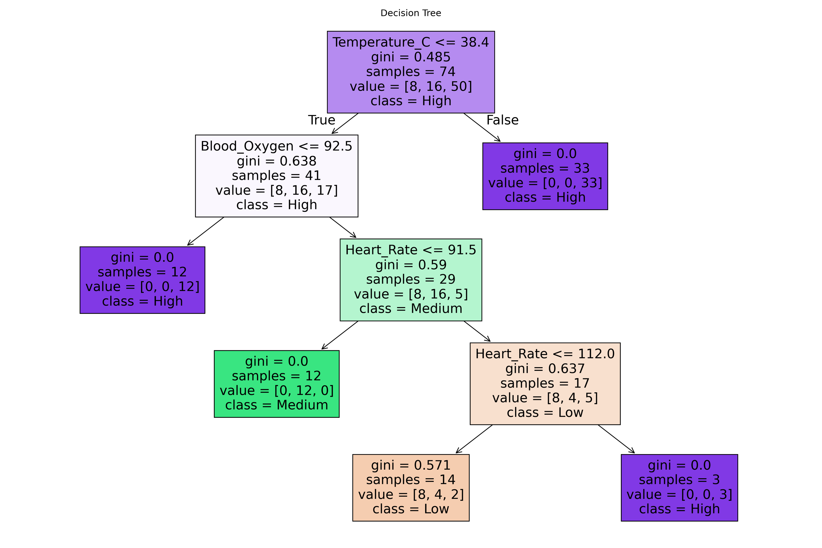
Decision Tree
Rule-based decision structure
Splits data using thresholds
Transparent and interpretable
Notes:
The decision tree visually represents how the model makes decisions. Each split is based on a threshold value, such as temperature or oxygen level.
👉 Example explanation:
For example, if a patient has a high temperature and low blood oxygen, the model quickly classifies them as high risk.
👉 Deeper insight:
This step-by-step logic closely mirrors clinical reasoning, where doctors evaluate symptoms against known thresholds.
👉 High-mark concept:
The interpretability of decision trees makes them particularly suitable for healthcare applications, where transparency is essential.

Slide 15
Conclusion
After completing this experiment, the following conclusions were made:
Machine learning can support medical decisions
The model itself performed well in its given task
The overall experiment demonstrates AI’s potential in the healthcare sector.
Notes:
In conclusion, this project demonstrates that machine learning can effectively assist in predicting patient risk levels. While simple, it highlights the potential of AI in healthcare.

